Slide 1
VOLTHA 2.8 Techinar
July 14, 2021 | 9am PDT
Andrea Campanella, Girish Gowdra, Hardik Windlass, Matteo Scandolo
ONF

Slide 2
Outline
SEBA RD 2.0 and VOLTHA Architecture, project state and deployments
VOLTHA Long Term Support Release and Strategy
VOLTHA 2.8 release
ETCD Persistence at scale
Multi User Network Interface (multi-UNI) Support
IETF Bandwidth profile and 5 TCONT Selection
Performance Measurements and Alarms
Platform stabilization (ONOS 2.5, Distroless images, bug-fixes, OMCI channel, voltctl, ONU SW image update)
Testing and Certification of new OLT
VOLTHA 2.9 Roadmap
Q/A

Slide 3
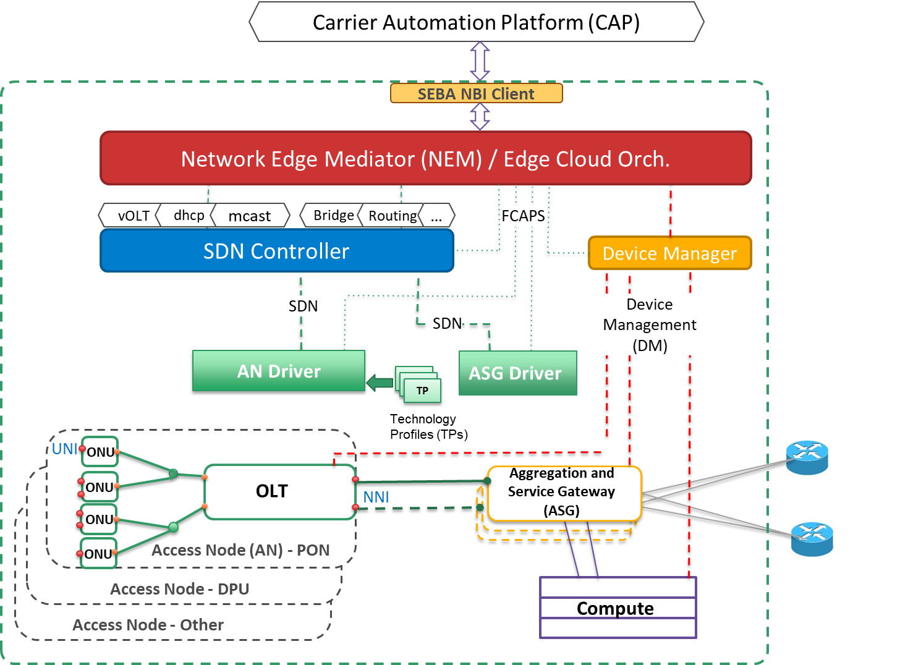
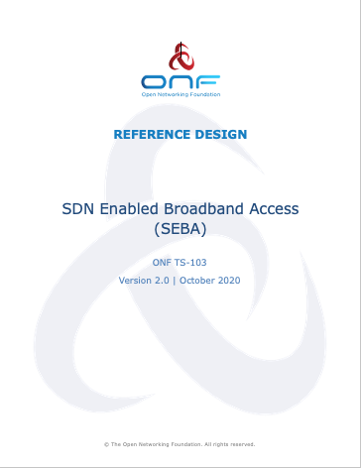
SEBA Reference Design Architecture
SEBA is a lightweight platform for development of solutions for carrier broadband access
SEBA RD v 2.0:
Disaggregated Broadband Network Gateway (BNG)
Per-OLT VOLTHA Stack Model for Scaling
Detailed NBI APIs
Device Management (DM)
Seba RD 2.0 is Released SEBA RD 2.0 Webinar

Slide 4
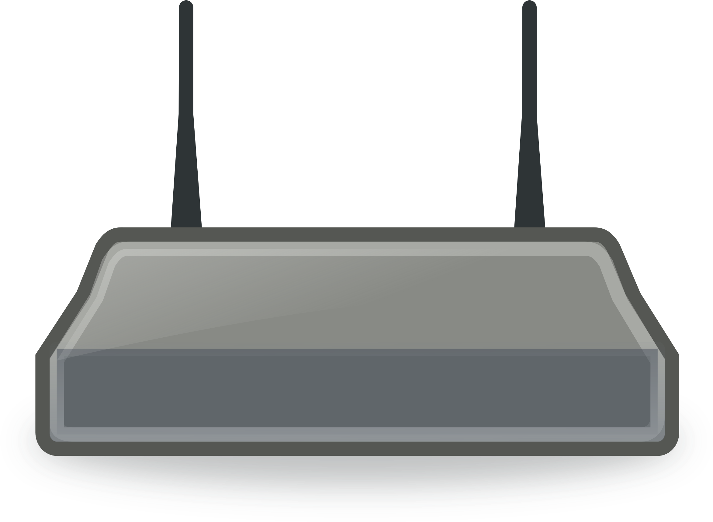
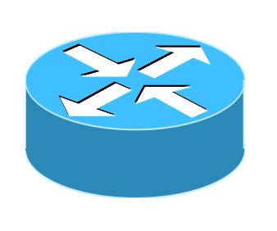
SEBA 2.0 Exemplar Architecture
ONAP
Operator OSS/BSS
SEBA POD
Local adaptor
Network Edge Mediator (NEM)
Edge orchestration and FCAPS micro-services
Docker
Kubernetes
Helm
VOLTHA apps PON/OLT control
TRELLIS apps
Fabric control
BNG-CP apps
Subscriber control
Focus on access: ONOS and VOLTHA
SOFTWARE STACK
SDN Controller - ONOS
OpenFlow
P4Runtime,
gNMI/OpenConfig
VOLTHA
BNG-UP
RG
ONU
Stratum
Whitebox OLT
whitebox switch
Core
PON
Whitebox OLT
whitebox switch
HARDWARE
Compute
servers

Slide 5
VOLTHA: Virtual OLT Hardware Abstraction
Common Control & Management for PON networks (OLTs and ONUs)
Different brands of OLTs and ONUs
Multiple services and operator workflows (ATT, TT, DT)
Device Management Interface for non datapath operations (e.g olt software upgrade)
Scale deployments (10 Stack with 10240 subscribers with the same infra)
Software update (VOLTHA and ONUs)
Hardware, scale, soak testing
ONOS
ONOS 1
ONOS 1
Openflow
Client
(eg. OFAgent)
VOLTHA core
Etcd
kafka
kafka
OpenONU
Adaptor
OpenOLT
Adaptor
OMCI
Device Management Interface
ONU
Whitebox OLT
OpenOLT driver/agent
ONU
ONL
BAL
ONIE
SDK(s)
VOLTHA 2.7 Webinar https://docs.voltha.org/master/release_notes/voltha_2.7.html
ONU
Notes:
OLT is abstracted with olt-adapter
ONU is abstracted with onu-adapter
ONUs + OLT are abstracted to the SDN controller as a switch
A constellation of OLT and ONUs is exposed via a single SDN controller

Slide 6
VOLTHA Deployments with Operators
Voltha is in production with live customers:
Deutsche Telekom (DT) as part of the A4 project
https://www.telekom.com/en/media/media-information/archive/deutsche-telekom-s-access-4-0-platform-goes-live-615974
Turk Telekom (TT)
https://www.aa.com.tr/en/science-technology/turkish-gsm-giant-makes-global-move-in-network-tech/2126349

Slide 7
VOLTHA Long Term Support Releases
Long Term Support means that throughout the lifetime of a release there is a commitment to update, patch and maintain the software (more info)
VOLTHA is a stable feature-rich project and has reached a level of maturity where it can be meaningfully used by others as part of their product or solution.
VOLTHA 2.8 is the first Long Term Support release of the project.

Slide 8
VOLTHA Long Term Support Releases
VOLTHA Long Term Support process is as follows:
18 months support with bug fixes and testing
LTS releases are 18 months apart.
6 month release cycles
Two interim releases between LTS versions.
Bugfixes will be backported to LTS (if applicable) from master and interim release.
LTS gives operators and users more confidence and attracts more users
“We applaud the ONF VOLTHA Community for this milestone achievement. With carrier grade VOLTHA solutions being deployed in production, Network Disaggregation has become a reality. We are looking forward to continuing this fruitful community collaboration.” Manuel Paul, Deutsche Telekom’s Product Owner for VOLTHA development.

Slide 9
ETCD Persistence at scale
VOLTHA storage through ETCD (pre 2.8) had issues in space occupancy, write speed and use of persistent storage with upstream BITNAMI Charts.
ETCD 6.2.5
Compacted technology profile instances
Removal of flows storage in the rw-core.
Openolt adapter read-through cache
ETCD connection pool in voltha-lib-go
Optimization of stored attributes
Automatic compaction and defragmentation
Use of nVME disks
Lowered disk space usage by 80%, faster bring-up and provision time of 1024 ONUs (2 mins) with persistence enabled for failure scenarios

Slide 10
Performance Measurements
ANI-G Test message support to fetch rx/tx power at the ONU
ONUi-PON and ONUi-GEMj counters
Extended Ethernet PM counters
Ethernet Bridge History
GEM Port History
FEC History
OLT Transceiver data via DMI
Collaboration with operators to ensure better network visibility, debugging and live analysis

Slide 11
IETF Bandwidth profile
Added IETF representation of the Bandwidth profile:
PIR /PBS (peak information rate, maximum bandwidth)
CIR/CBS (committed information rate)
GIR (guaranteed bandwidth)
{ "id": "DT_downstream_default_bw_profile", "pir": 1168192, "pbs": 0, "cir": 0, "cbs": 0, "gir": 0 }
Extends previous MEF definition that used EIR/EBS (excess information rate, burst size) and AIR (assured information rate). If we define EIR, CIR, AIR we will calculate PIR =CIR + EIR + AIR.

Slide 12
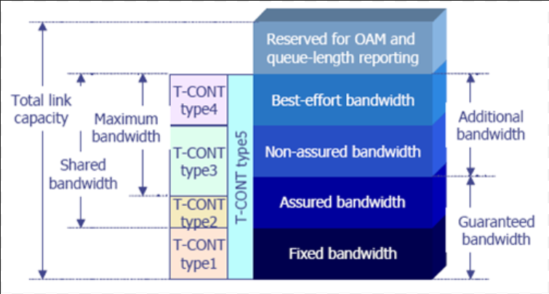
5 TCONT Selection
5 Tcont type selection:
Two meter-bands with burst size = 0 (Tcont type 1, PIR=GIR)
One meter-band with burst size = 0 (Tcont type 1, only GIR is specified)
Two meter-bands with burst size > 0 (Tcont type 2 / Tcont type 3, PIR=CIR / PIR > CIR)
One meter-band with burst size > 0 (Tcont type 4, only PIR)
Three meter-bands (Tcont type 5, PIR > CIR + GIR)
Fine grained quality of service (QoS) for each subscriber

Slide 13
Multi User Network Interface (multi-UNI) Support
Use all use network interface (UNI) ports of an ONU
all ports are active and enabled in VOLTHA and ONOS
Capability to provision subscribers on all UNI ports
different Bandwidth profiles for ONUs and OLTs
support for all workflows and multi-tcont
Mask for amount of enabled ports.
Support in BBSIM
ONOS
VOLTHA core
OpenONU
Adaptor
Fully leverage ONU/ONT Device Capabilities and expand service capability at the same cost

Slide 14
Platform stabilization
ONOS 2.5 LTS
Expanded ONU software upgrade capability
Retrieval of image specifics via OMCI of the images from the device
Separation of download/activate/commit APIs
Time optimization
OMCI channel
message send/receive failure handling
retry mechanisms in openonu adapter
Voltctl extensions
Multi-stack support
Groups list
Retrieve of Performance Metrics
Distroless and non root docker images for production deployment security
Bug fixes

Slide 15
Turk Telekom Testing
Expanded Turk Telekom hardware tests from 5 to 19, including error and failure scenarios
Disable/Enable ONU
Disable/Delete OLT
Open-olt, Open-onu, Rw-core, Of-agent Restart
Delete/Re-add (reprovisioning) Subscribers
ONU and OLT Physical and Soft Reboot
All done on XGSPON whitebox OLT with different ONU brands and multiple technology profiles for different services needs
Notes:
OLT is abstracted with olt-adapter
ONU is abstracted with onu-adapter
ONUs + OLT are abstracted to the SDN controller as a switch
A constellation of OLT and ONUs is exposed via a single SDN controller

Slide 16
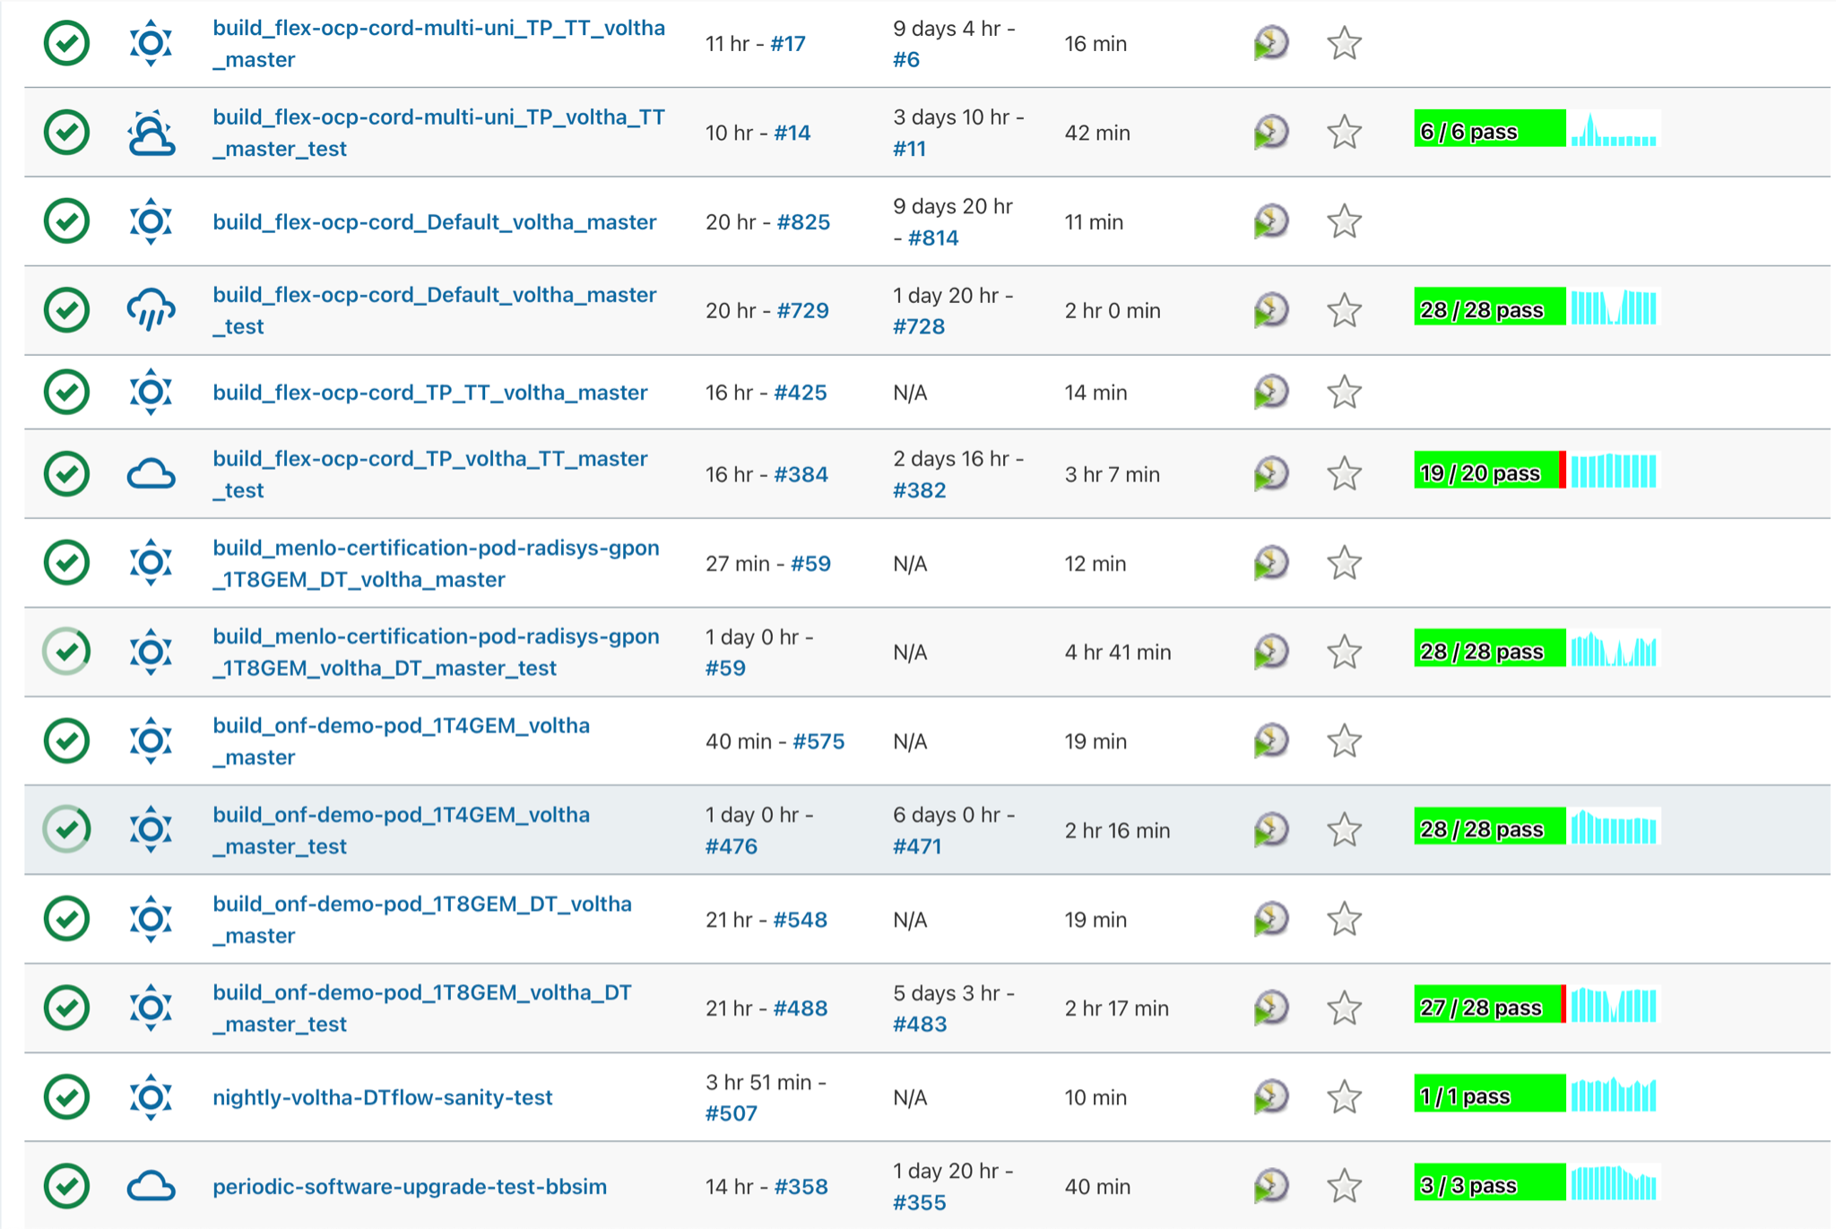
VOLTHA+ONOS 2.8 Testing
New 2.8 Tests
Multi-UNI Testing
Performance Metrics (ANI-G)
Multi-Tcont testing
Updated ONU sw upgrade
Automated Soak testing
OMCI Chaos Monkey
Nightly scale and 180+ Hardware tests
Jenkins view for 2.8 Tests
https://jenkins.opencord.org/view/VOLTHA-2.8/
Notes:
OLT is abstracted with olt-adapter
ONU is abstracted with onu-adapter
ONUs + OLT are abstracted to the SDN controller as a switch
A constellation of OLT and ONUs is exposed via a single SDN controller

Slide 17
Continuous Certification -- Radisys 3200G
VOLTHA 2.8 adds the Radisys 3200G GPON OLT to the Certified Hardware
whitebox OLT
32 GPON ports
openolt agent and adapter
More info: https://radisys.com/connectopenbroadband/olts
Notes:
OLT is abstracted with olt-adapter
ONU is abstracted with onu-adapter
ONUs + OLT are abstracted to the SDN controller as a switch
A constellation of OLT and ONUs is exposed via a single SDN controller

Slide 18
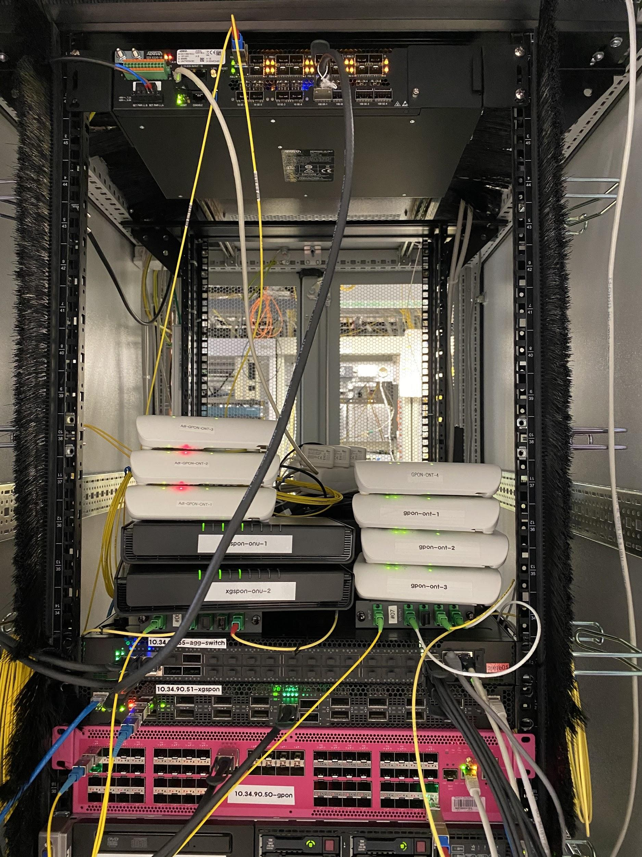
Continuous Certification
180+ nightly Tests certify several HW:
Edgecore ASFVOLT16 (XGSPON)
Edgecore ASGVOLT64 (GPON)
Radisys 3200G (GPON)
Adtran SDX 6320 (GPON) -- in progress
Sercomm FG1000 (GPON ONU)
Edgecore 7712 (Agg switch)
Edgecore 6712 (Agg Switch)
ONF Marketplace:
https://opennetworking.org/marketplace/?_product_project=voltha
Operator’s Procurements is based on successful ONF certification https://opennetworking.org/continuous-certification-program/
Notes:
OLT is abstracted with olt-adapter
ONU is abstracted with onu-adapter
ONUs + OLT are abstracted to the SDN controller as a switch
A constellation of OLT and ONUs is exposed via a single SDN controller

Slide 19
2.8 Accomplishments
ETCD Persistence at scale with ETCD 6.2.5 and upstream BITNAMI charts
Multi User Network Interface (multi-UNI) Support with testing
New IETF Bandwidth profile format to be compatible with more OSS/BSS
5 TCONT Selection to support all bandwidth/Qos requirements
Extended Performance Measurements and Alarms
Platform stabilization (ONOS 2.5, Distroless images, bug-fixes, OMCI channel, voltctl, ONU SW image update)
Expanded Testing suite, especially TT and alarms/OMCI
Certification of new Radisys 3200G OLT
https://docs.voltha.org/master/release_notes/voltha_2.8.html
Notes:
OLT is abstracted with olt-adapter
ONU is abstracted with onu-adapter
ONUs + OLT are abstracted to the SDN controller as a switch
A constellation of OLT and ONUs is exposed via a single SDN controller

Slide 20
VOLTHA 2.9 Roadmap
gRPC migration from KAFKA for inter VOLTHA services communication
ONU Adapter Code Modularization and Channel based flow config
TT multicast test and IGMP at scale
Containers resource limits
Alarms and PMs (LOS and Loss of PLOAM)
ADTRAN and Radisys OLT certification
Extend multicast, IGMP, multi-UNI tests
BAL upgrade (possible)
MPLS support (possible)
Notes:
OLT is abstracted with olt-adapter
ONU is abstracted with onu-adapter
ONUs + OLT are abstracted to the SDN controller as a switch
A constellation of OLT and ONUs is exposed via a single SDN controller

Slide 21
SEBA Community
AT&T
Notes:
Today we present the work of a large community that includes both operators and vendors

Slide 22
Thank You
Follow Up Links:
docs.voltha.org
andrea@opennetworking.org
teo@opennetworking.org
girish@opennetworking.org
hardik@opennetworking.org

