Slide 1
Disaggregation Insights, Challenges, State of the Industry
Paul
Gunning
BT
An Interview with a Subject Matter Expert, Paul Gunning
Broadband Meetup, October 19th, 2023

Slide 2
Industry Questions
How do operators navigate this space to build for the networks of tomorrow?
What’s been happening in BT with respect to Disaggregation projects ?
What are the challenges that are you currently facing with the business case for disaggregated solutions
With more nascent technologies such as BNG CUPS, OpenOLT & VOLTHA becoming topics of great interest from the industry, how can the industry ensure that requirements defined by SDO’s such as the BBF and TIP match what operators like [BT] and others need?

Slide 3
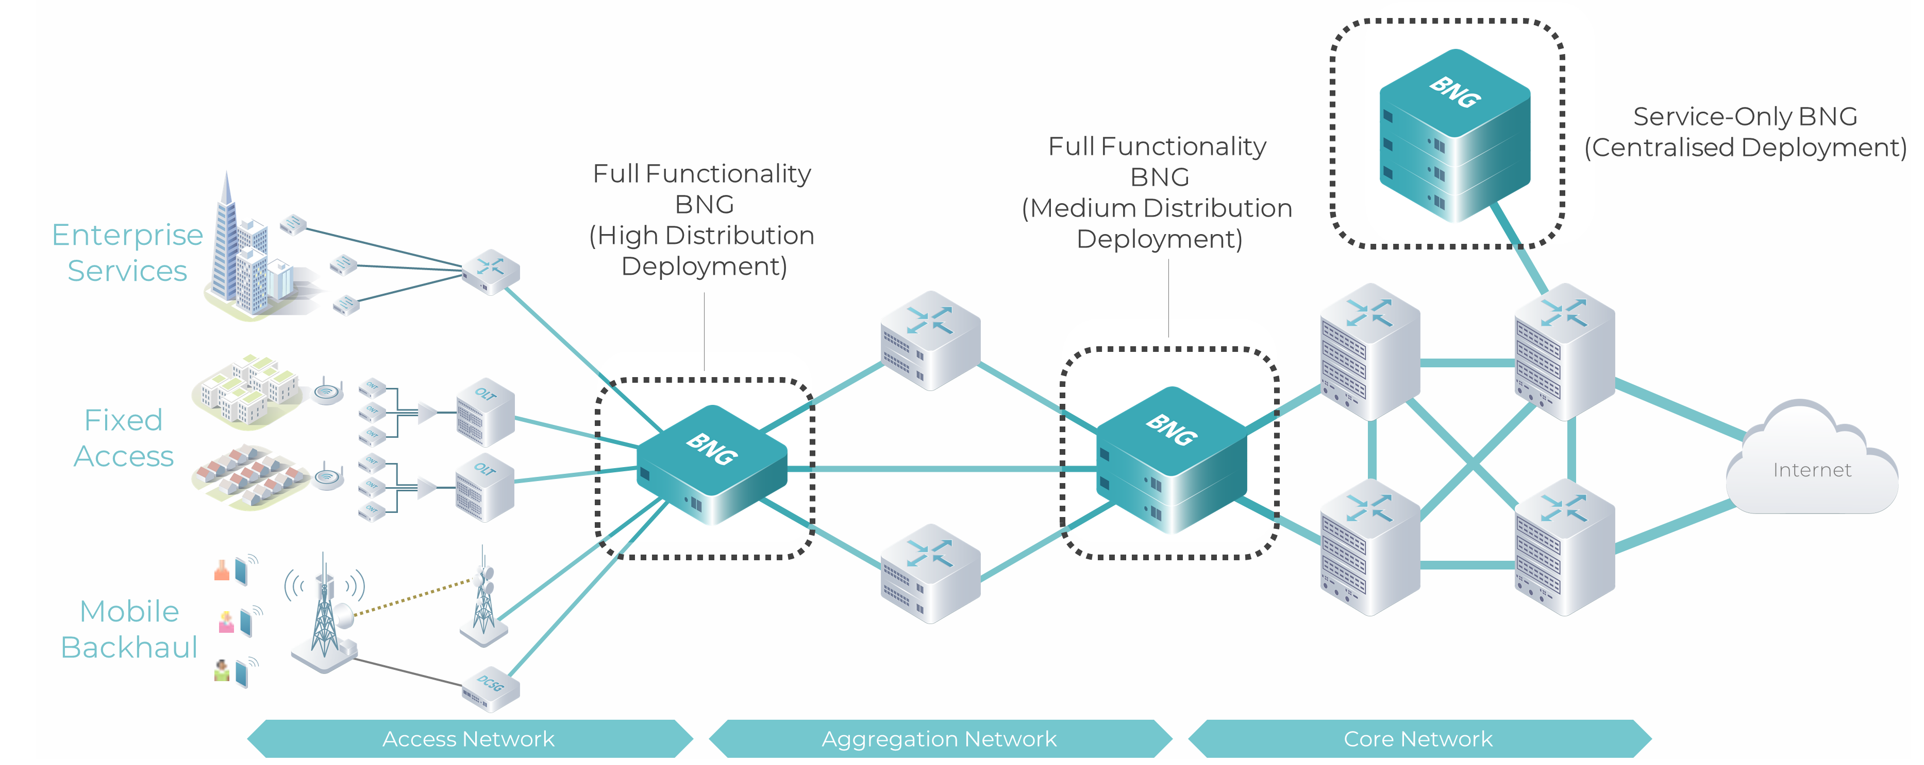
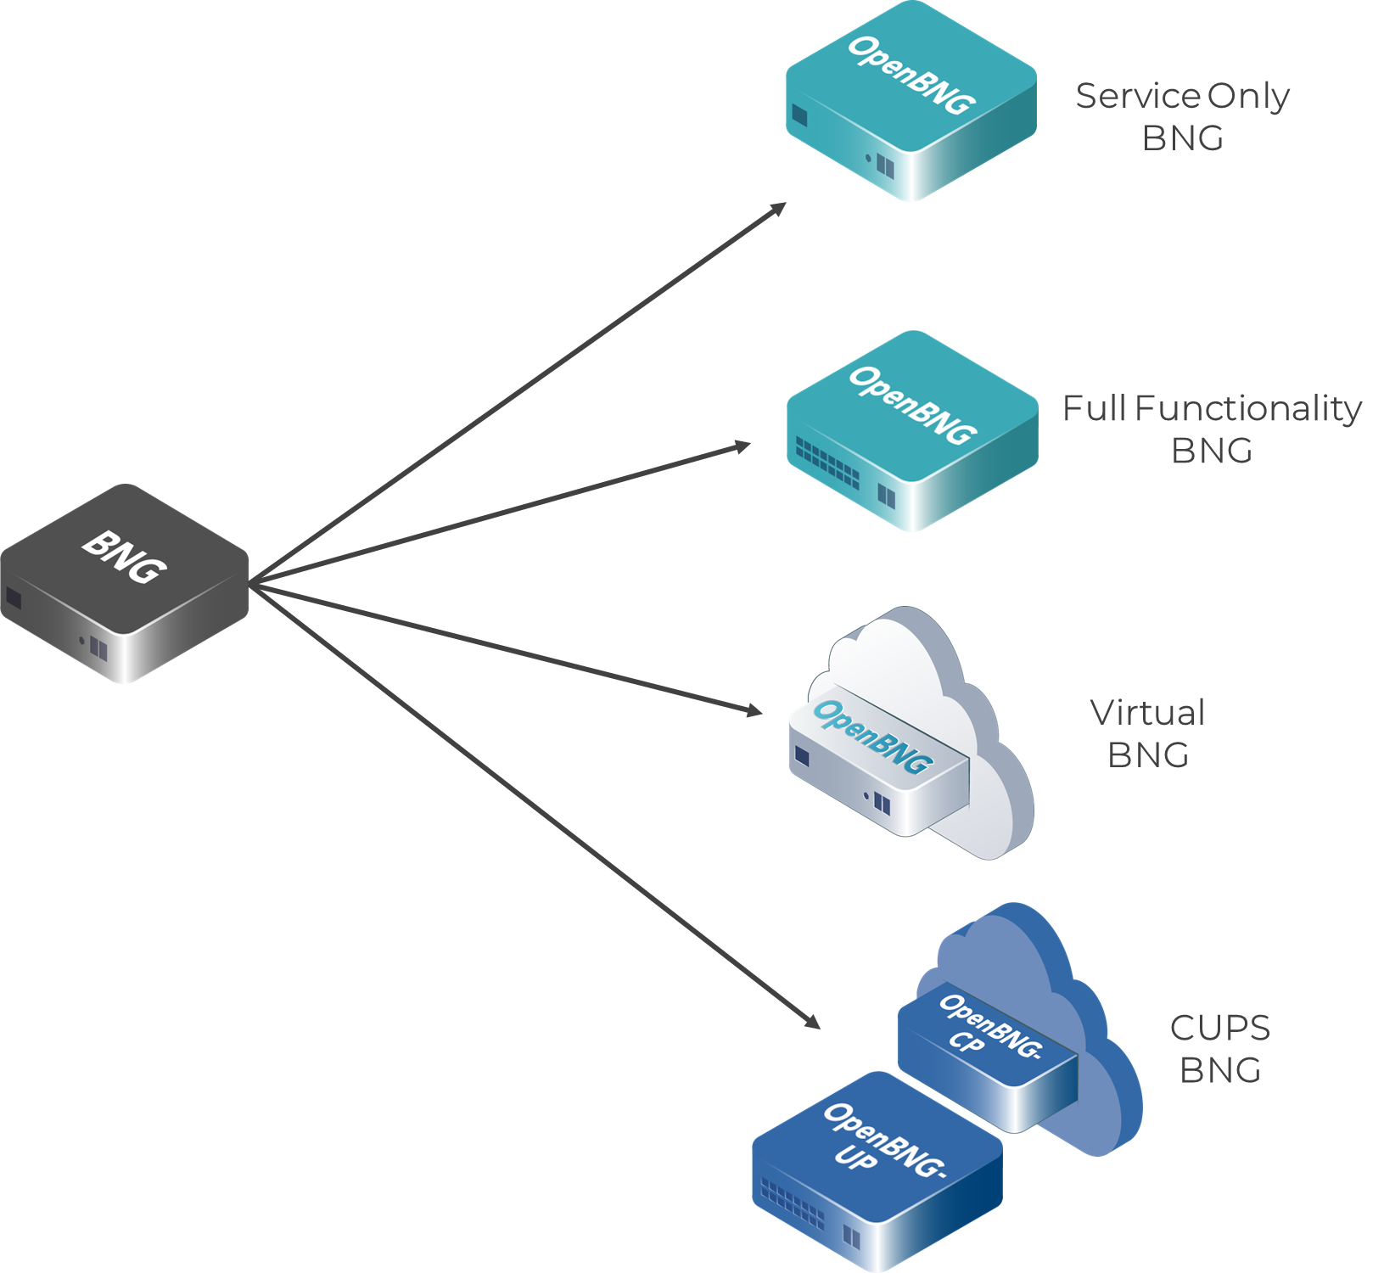
Example: BNG Deployments – State of Play
Where have we come from?
Traditional architecture of monolithic devices and centralized deployments
1 device built for high subscriber count and capacity
Deployed at Data Centre/Large POPs (centralized deployment models)
Large platform feature-set (e.g. PE routing functionality + BNG)
Use Cases have changed this landscape
In-line vs Service-only BNG deployment models
Distributed deployment models (smaller POPs)
BNG Resiliency
And even further with technology evolution
Device form factor enhancements (More Gbps per RU!)
New Service Architectures (vBNG, CUPS)
As an operator, how does one navigate this space in order to build for the networks of tomorrow?
Source: FYUZ 2023, Madrid

Slide 4
?

